Slide 1
Census Data Analytics
Paulo C. Rios, Jr.
Sep 21, 2017

Slide 2
Goals
Using the “Adult” dataset, predict whether income exceeds $50K/yr based on census data.
Choose an accuracy statistic to measure model’s accuracy.
“Adult” dataset available at http://archive.ics.uci.edu/ml/datasets/Census+Income

Slide 3
Actions
Using a Python Jupyter notebook, I have done the following:
Training Data Set Importing and Reading
Data Preprocessing
Feature Visualization and Transformation
Model Training and Performance Measurements
With two models: Random Forest and Stochastic Gradient Descent (SGD)

Slide 4
Data Preprocessing

Slide 5
Steps
Columns were renamed
Target feature had its value reset as True/False
Null values were removed
Original training data set had 32,560 rows
Without null values, training data set has 30,161 rows

Slide 6
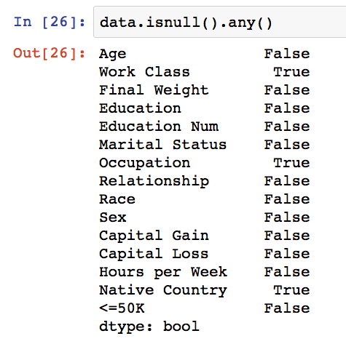
Null Values

Slide 7
Feature Visualization

Slide 8
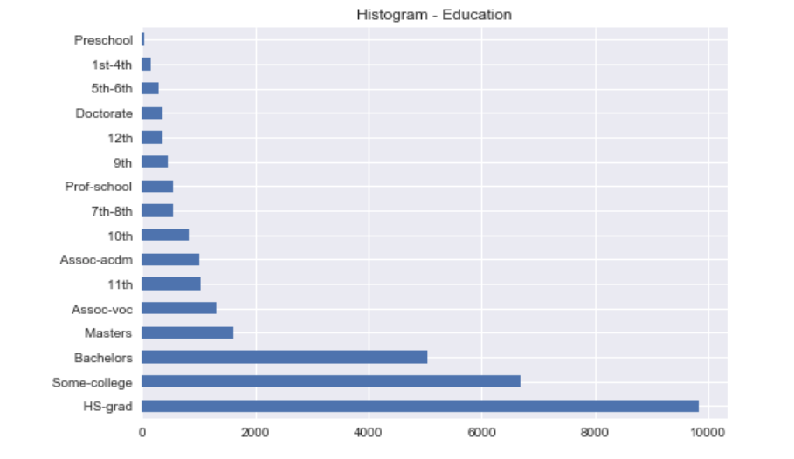
Education

Slide 9
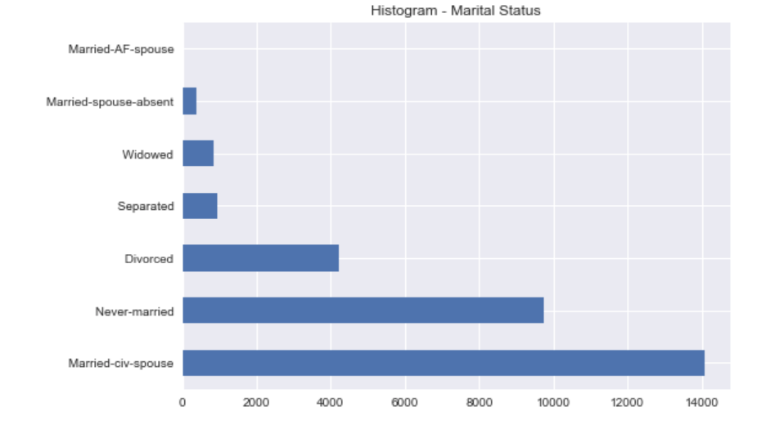
Marital Status

Slide 10
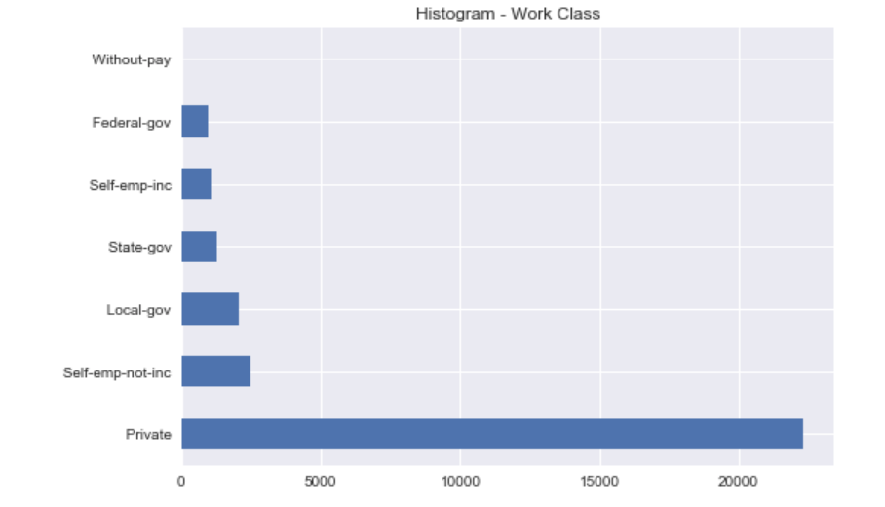
Work Class

Slide 11
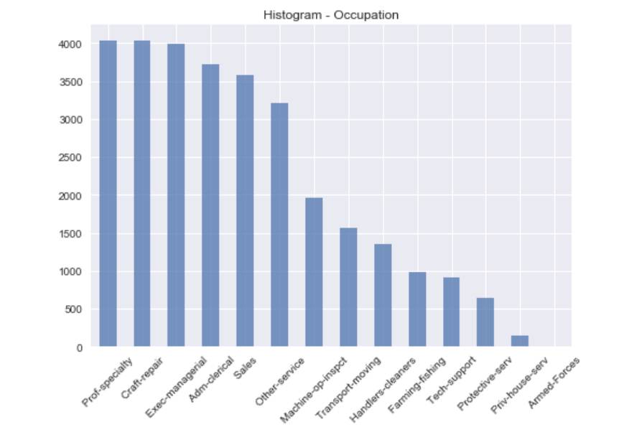
Occupation

Slide 12
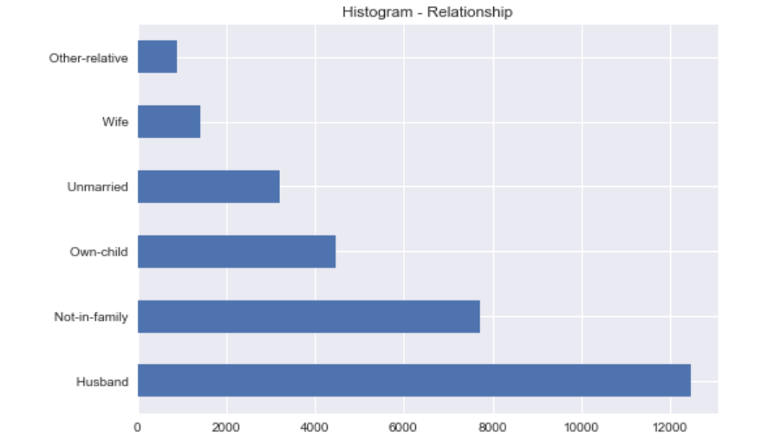
Relationship

Slide 13
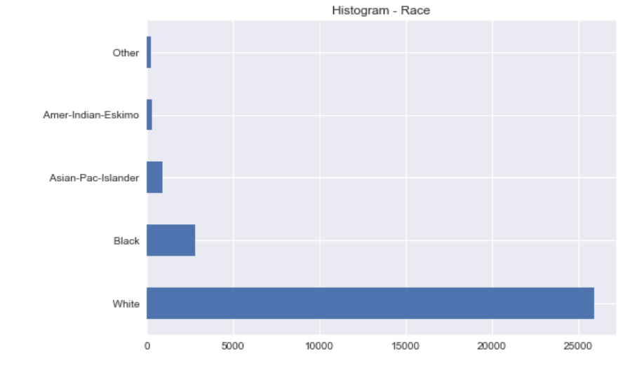
Race

Slide 14
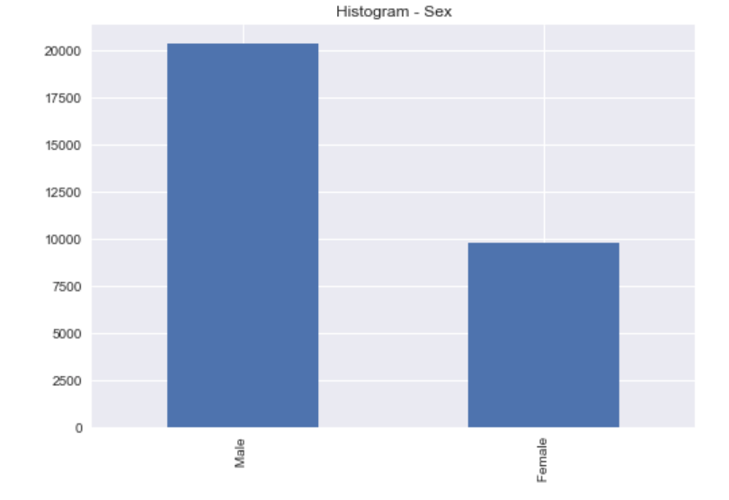
Sex

Slide 15
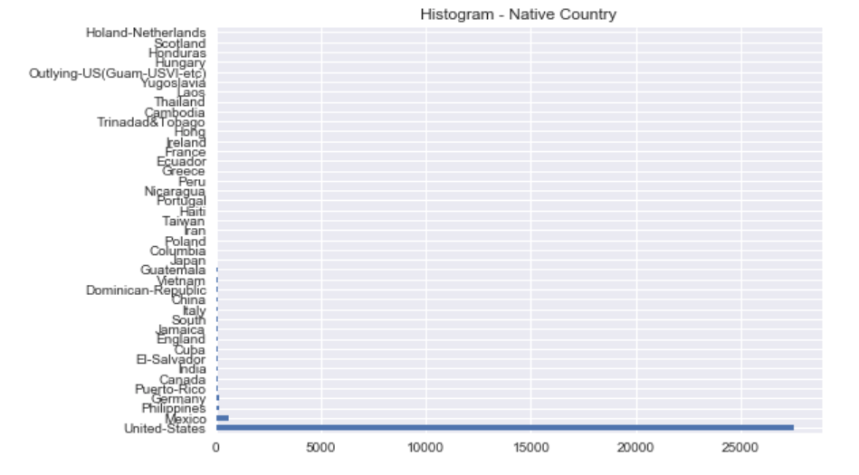
Native Country

Slide 16
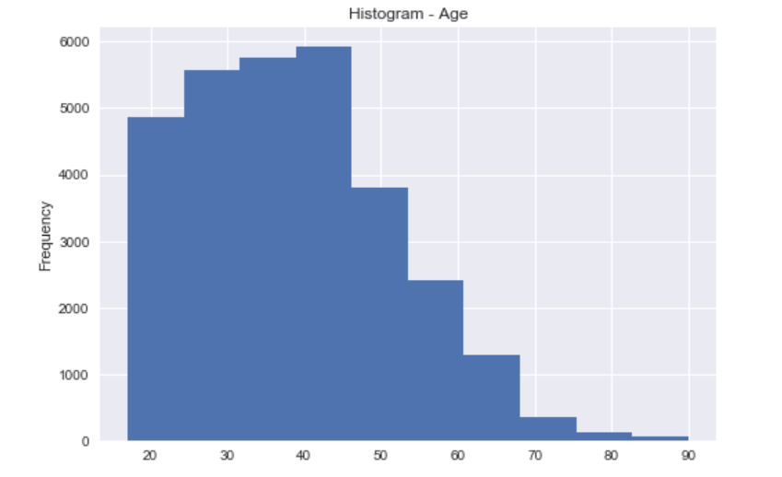
Age

Slide 17
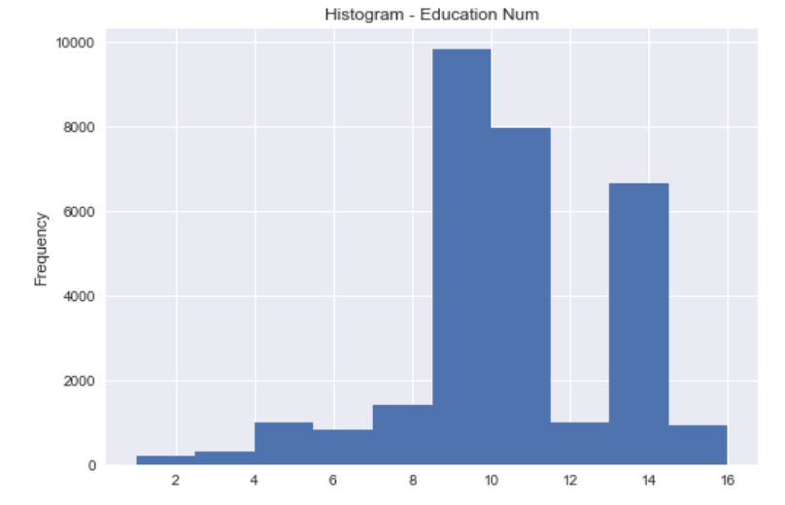
Education - Num

Slide 18
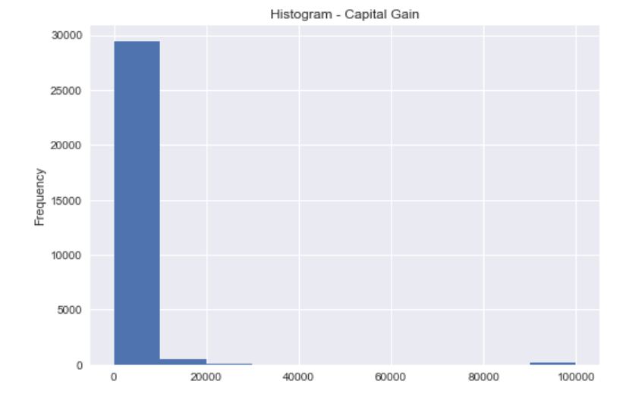
Capital Gain

Slide 19
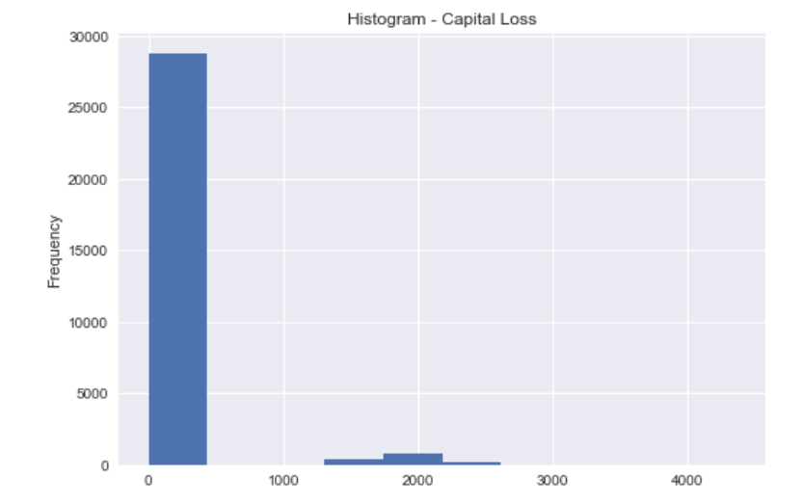
Capital Loss

Slide 20
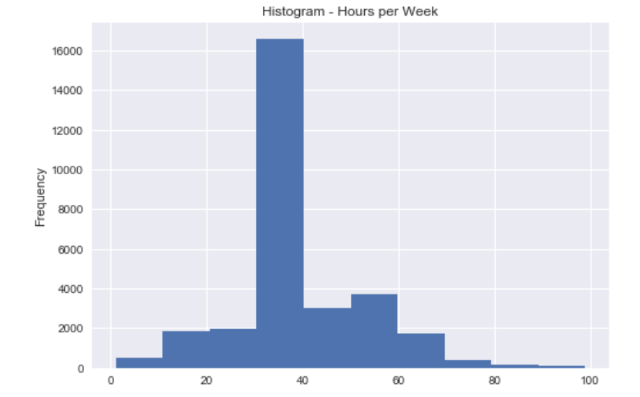
Hours Per Week

Slide 21
Model Training and Performance Measurements

Slide 22
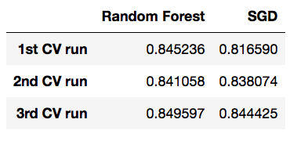
Cross-Validation Accuracy Scores

Slide 23
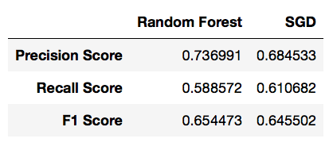
Confusion Matrix Scores

Slide 24
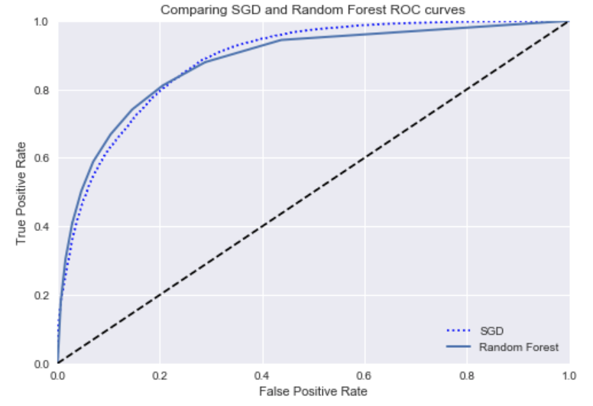
ROC Curves

Slide 25

ROC AUC Scores

Slide 26
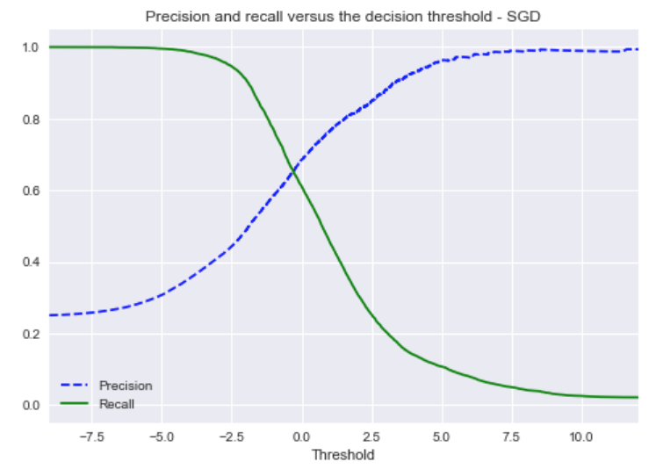
Precision and Recall - SGD

Slide 27
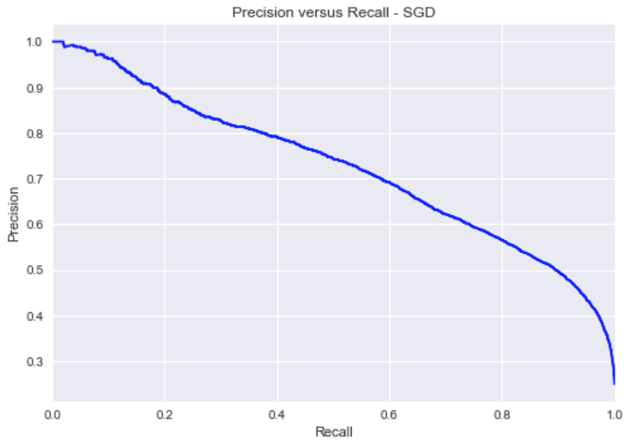
Precision and Recall - SGD

Slide 28
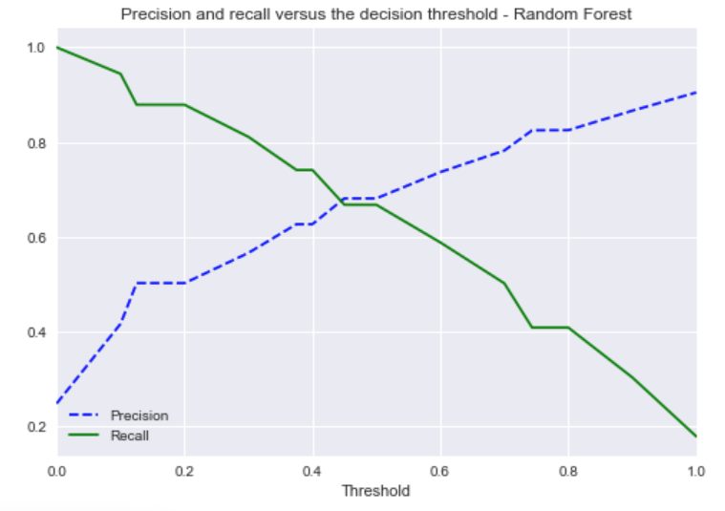
Precision and Recall Random Forest

Slide 29
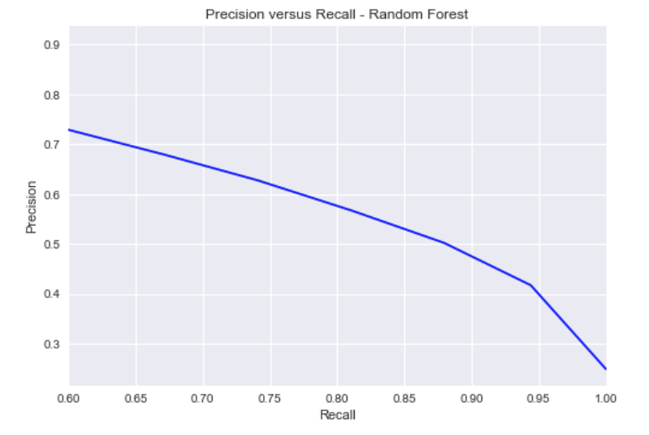
Precision and Recall Random Forest

Slide 30
Next Steps
Remove outliers and check effect on performance measurements
Choose best precision/recall tradeoff for best classifier
Fine tune best classifier with Grid Search
Perform data preprocessing and transformation on the test set
Evaluate best performing classifier on the test set

